Slide 1

A Curriculum First Approach to
Technology & the Web
March 30, 2016
Michael Casey

Slide 2

Michael Casey
35 Years in Education:
Teacher, Resource Teacher, EdTech Program Manager,
Executive Director IT
Author: N3XT Practices, VISION
President/CEO Eire Group

Slide 3

Notes:
When it came to writing - this was me in school
cumbersome, painful, hated to edit, hated to re-write (in fact wouldn’t do it), wouldn’t want to share my work
not good at it!
If it wasn’t for wood shop i don’t know if i would have finished high school
loved math and science - how do we make school for EVERYONE
the two smartest people i know ….

Slide 4
We believe in the Web
as a learning platform.
Notes:
tell you more about their curriculum first approach, and how they are using technology to help them achieve broader student learning goals, but first we thought it would be helpful to give a high level goal of Google in Education
We've been working with 1000's of schools that are deploying technology into the classroom, and before embarking on a selection process, we feel it's important to remember that technology is NOT new to this generation.
What we see as an amazing flashy engaging technology is just par for the course for many students.
Students today never knew a world without smartphones, social media, and digital learning, so we feel it's important to keep their perspective in mind and remember that a device with some apps alone will not keep students engaged, and that technology is just a tool!
At Google, we believe in the power of the web to help people discover, connect, and learn. Our company’s mission “to organize the world's information and make it universally accessible and useful," and education lies at the very core of that mission.
The goal of the Google EDU team is to bring the power of the web to students today, and this goal goes far beyond just a Google search-- We believe in the web as a learning platform.
We have a huge interest in preparing students with the applied technology skills they will need to thrive in the workplace of tomorrow, and we believe in the web as a platform for learning that can help students achieve this goal...
Here are a few reasons why:

Slide 5
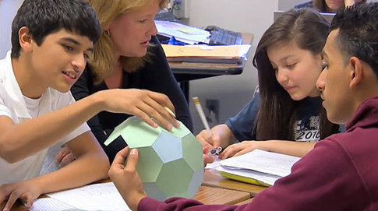
Engages stakeholders and promotes
21st century skills
Why the web?
Notes:
We also believe that the web is the best platform for learning because it engages all stakeholders and promotes 21st century skills.

Slide 6

Allows dynamic learning
Why the web?
Notes:
I wanted to take a little bit of time to expand more on "why the web?"
When you're using the web as your learning platform, it enables you to have a dynamic learning environment.

Slide 7

Prepares students for their
future careers
Why the web?
Notes:
The web is also the best platform for learning because it prepares students for their future careers.

Slide 8

Communication
Collaboration
Critical thinking
Creativity
Notes:
There needs to be more of a focus on "21st century skills" like communication, collaboration, critical thinking, analysis, and problem solving.
When you're using a dynamic learning environment in the classroom, you move away from the traditional model of a teacher as a lecturer and start involving students. They are able to collaborate on presentations and documents and work together to learn, rather than just taking notes. It creates an environment where a teacher is acts as a facilitator for learning.

Slide 9

Introducing Del Mar Union School District
Mike Casey
Director of Technology (Retired)
Notes:
I'll be back in a little bit to talk more about our products and solutions, but first I'd like to turn it over the Del Mar Union School District to tell you their amazing story!

Slide 10


Del Mar Union School District Overview
Suburban school in California near San Diego
4000 students
Eight Elementary schools

Slide 11
A Curriculum Approach to
Technology Integration
Notes:
MIKE: Intro
How we used a curriculum approach to integrating technology.
How we were very successful in our integration efforts
Relationship between Curriculum and Technology leadership

Slide 12
Steps to Success
Curriculum
Applications that support your curriculum
Technologies to support applications and curriculum

Slide 13
Strategic Plan
Curriculum Focus -- 3 Core Areas
Education Program
Technology
Professional Learning
Notes:
Facilities, Budget, Communication, External Resources
District started with a strategic plan involving all key stakeholders:
Community members, school board, teachers and staff, district administration
Resulted in a plan with 7 areas where core objectives were developed initial district focus
Educational program, technology, professional learning
Within the ed program, determined LASER FOCUS on writing
Professional learning initially involved teachers learning more about effective instructional practices in writing
As a result of this work over 1 1/2 years, began to search for a tool we could provide teachers and students to support instruction of writing and production of writing in our students

Slide 14
The most important relationship in your organization that will help ensure successful technology integration, is that between Curriculum and Instruction and Information Technology.

Slide 15

Focus on Curriculum Initiatives, not Technology Initiatives.
Notes:
So really the incorporation of technology, and I can't stress this enough, began with curriculum and instruction, not technology
We did not acquire technology, then try to figure out the purpose for having the technology
We were clear and intentional about our instructional focus and THEN, determined the need for technology
Great quote by Alan November: 'Technology is often a solution looking for a problem'... this is backward implementation model
Technology and and C&I in a collaborative relationship: DO NOT want to create instructional competition between technology and content

Slide 16
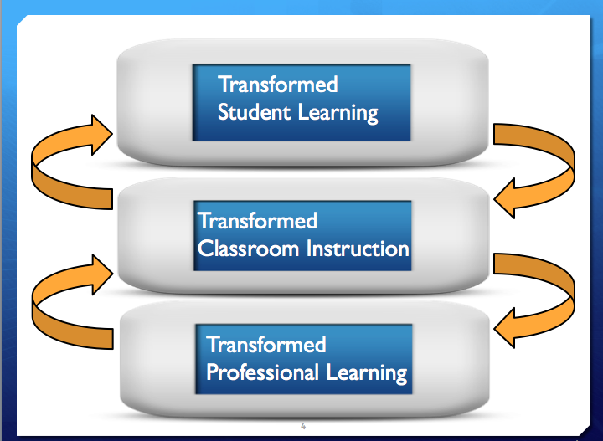
Notes:
SHELLEY:
Improving student learning and achievement is at the center of all our district decisions
Slide by Joellen Killion illustrates the interconnectedness between professional learning, classroom instruction and student learning.
This approach, you'll see later, is the same for incorporating the technology into classrooms with 1-1 student devices

Slide 17
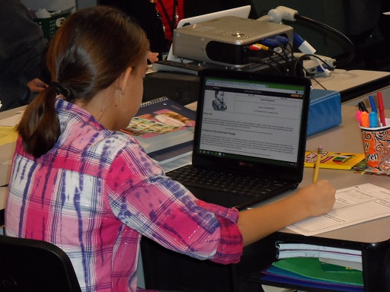
Laser Focus and Commitment
Common Core State Standards
Writing
Professional Learning Model
Writing
Technology
21st Century Skills
Notes:
SHELLEY:
A lot of distractions exist in education, but with a determined Focus and Commitment to on writing
We are tying effective instructional practice to CCSS and student learning reflective of CCSS
Need for high quality professional learning cannot be understated:
Incorporated the writing and technology
addressed the rigor in the form of student thinking reflective of 21st century skills, skills which can't be misinterpreted to solely imply the use of technology:
It's the USE of technology to foster critical thinking, communication, collaboration, and creativity

Slide 18
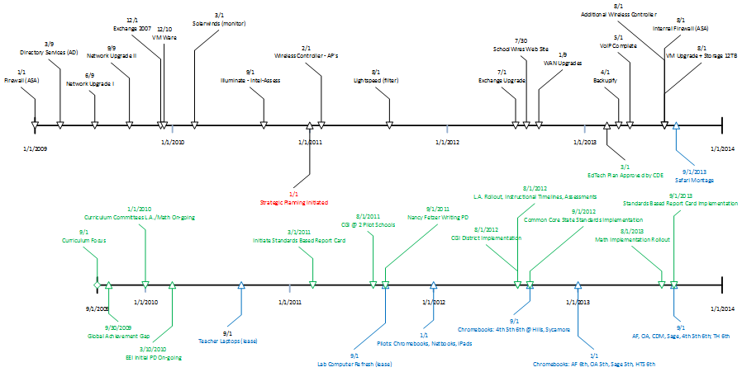
Timeline Development

Slide 19
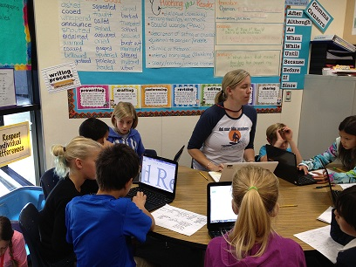
Tools to Support a Curriculum Focus
GAFE
Writing Process, Collaboration, Presentations, Sharing, Comments, Publishing, Communication
Notes:
storyboard, pre-write, write, re-write
students collaborating on an assignment - supports project based learning - learning in a performance team
sharing with teacher, peers, team partners
comments
publish via presentation, sites
everything supports communication about their learning and making their work public

Slide 20
Professional Learning
40 Hours/teacher
Summer
Substitutes for Peer Observation/Collaboration
Conferences
Notes:
SHELLEY

Slide 21
Tools to Support our Curriculum Focus
Goals of the Initiative
Attain district academic goals, which included maximizing the achievement of learning goals for 21st century skills, through the appropriate use of technology and media-rich resources. (Initial focus area will be written communications)
Provide access for meaningful, rigorous student-centric learning experiences for every student.
Notes:
MIKE
review of our project goals

Slide 22
Tools to Support our Curriculum Focus
Goals continued
Utilize high-quality educational software effectively as an integral and engaging part of the curriculum
Develop a plan for district-wide ongoing professional learning for teachers in technology fluency and integration to ensure a full, successful implementation
Provide a managed technical environment that ensures the safe delivery of resources to students
Notes:
MIKE

Slide 23
Tools to Support our Curriculum Focus
Google Apps for Education
Writing Process
Collaboration
Sharing
Teacher and peer comments
Publishing
Presentations
Spreadsheets
Communication
Notes:
MIKE
storyboard, pre-write, write, re-write
students collaborating on an assignment - supports project based learning - learning in a performance team
sharing with teacher, peers, team partners
comments
publish via presentation, sites
everything supports communication about their learning and making their work public

Slide 24
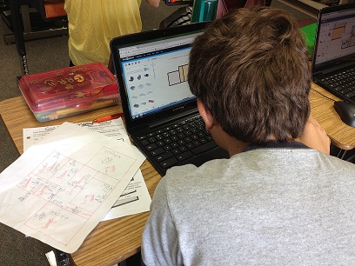

Tools to Support our Curriculum Focus
Prezi
Floor Planner
Edmodo
Glogster
Quizlet
Notes:
MIKE
Alternate presentation tool - freedom to be more creative - non-linear approach
complex math challenges

Slide 25
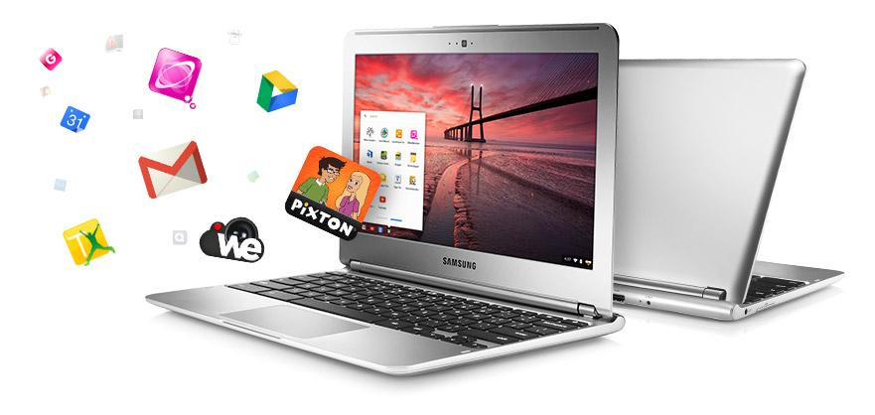
Chromebooks
Tool to evaluate technologies
Cost
Ease of Use
IT Support
Functionality with Google Apps
Wireless Infrastructure
Notes:
MIKE
Process for selecting CB
Curriculum focus first - WRITING
Apps to support the writing focus
The tool that we developed to help evaluate technology - we were a Mac centric district

Slide 26
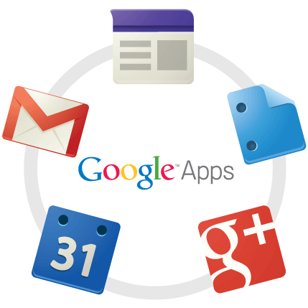

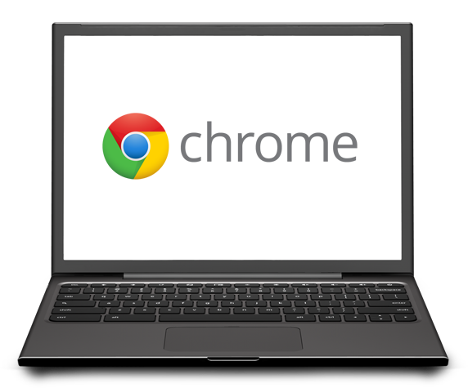
Google in Education
Platform
Apps & Content
Devices
Notes:
So, Google provides you with a platform in Google Apps. We provide you with strong web-based content through things like the Chrome webstore, YouTube for EDU, and the Google Art Project.
Additionally, we offer devices that allow you to pull together the platform and the content to design a transformative curriculum for your students. Chromebooks are computer that gives you a fast, easy, and affordable way to get to the web.
So with all of these technologies in place, we believe you can truly unlock the power of the web for your students.

Slide 27
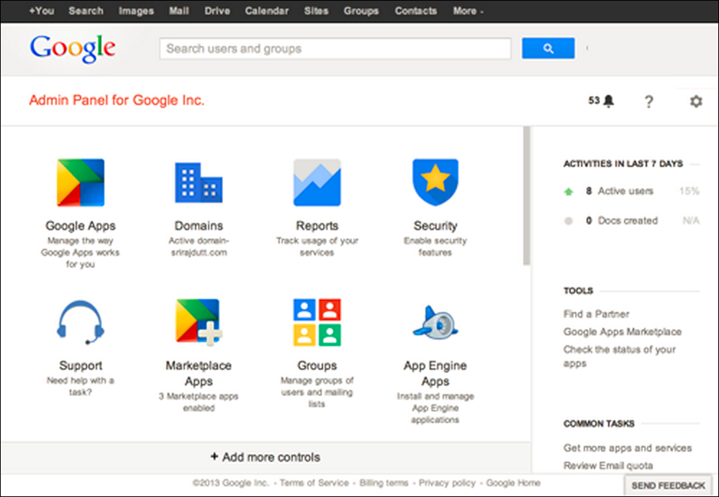
GAFE Management Console

Slide 28
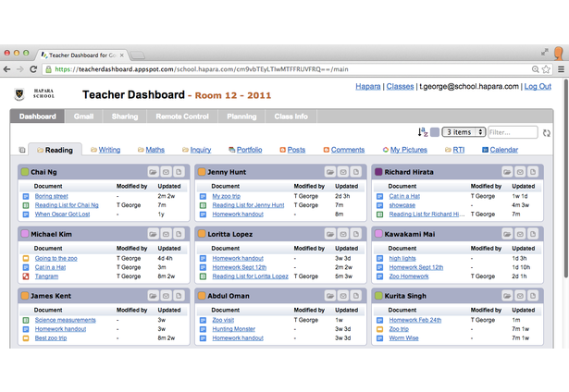
Hapara Teacher Dashboard

Slide 29



Technologies to Support our Initiative
UMRA (tools4ever)
Hapara - Teacher Desktop, Remote Access
Backupify
Notes:
MIKE
UMRA is a provisioning tool - student-> AD->google + Hapara
Hapara - teacher desktop - remote access - see all docs whether or not they are shared
Backupify - backs up all google docs, presentations, spreadsheets, sites etc. 3 times a day - end user can restore

Slide 30
My Philosophy
"One-to-One is not about the ratio
of devices to students.
It's about the interactions a teacher has
with each student."
Notes:
MIKE

Slide 31
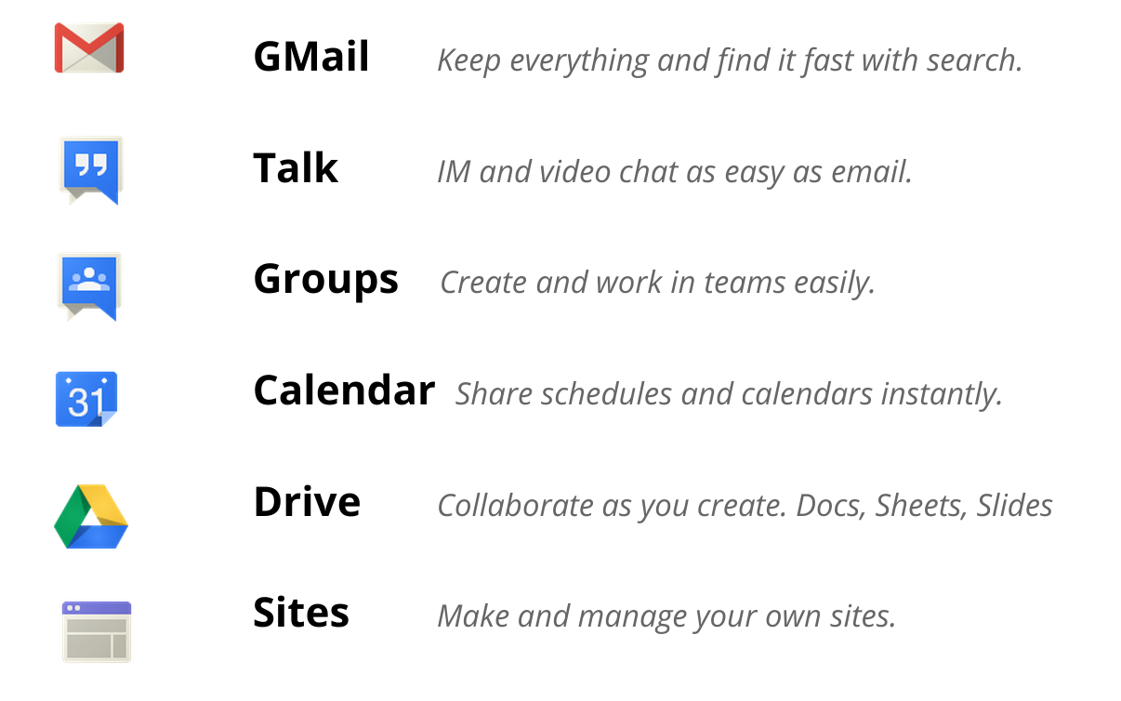
Google Apps for Education
Notes:
Firstly, google offers schools a free suite of services called Google Apps for Education. These apps include Gmail as your email service provider and things like docs, spreadsheets, and presentations for content creation. Since Google Apps are all web-based, it means that they are available from any device with a web-browser. They are also great for collaborating because multiple people can be creating and editing at the same time.

Slide 32
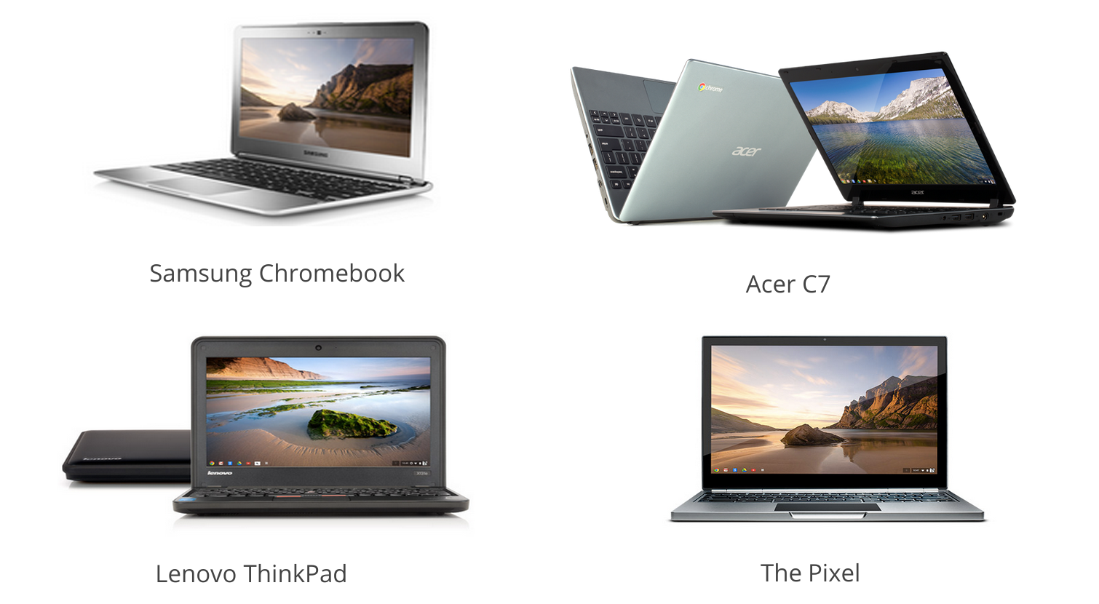
Google Chromebooks for Education
Notes:
So let's talk now about the devices available to schools.
As Mike mentioned, the Chromebook has proved to be an incredibly practical and useful tool for schools looking to deploy devices and increase access to educational and productivity tools.
At this point, there are several different Chromebook hardware options. There are differences in things like battery life, screen size, ports, and size... but the bottom line is that all of the Chromebooks are running on the same Chrome Operating System and using the same Chrome Management console, so the experience will be the same.

Slide 33

Chromebooks are a perfect fit for the classroom
Get to lessons faster
Same experience everywhere
Easy to share (or not)
No viruses or imaging
Notes:
Chromebooks are web-based computers that are great for schools because they are easy to use, easy to manage, and easy to customize, and easy to scale.
We've designed Chromebooks in Education to be practically invisible in the classroom. We believe that technology should be a tool to help you teach. But nobody is going to use a tool if it's too difficult or time consuming.
With Chromebooks, students open the lid, sign in, and are up and running in under 8 seconds. 8seconds. This is such a critical fact, because even taking a few minutes to load is too much time when you start thinking about ever day of the school year. Chromebooks allow you to dedicate more of your valuable time towards instruction.----Story of Edmonton...
When you're using Chromebooks, everything is stored on the web and so it doesn’t matter which machine you use. With Chromebooks, the focus isn't on the technology. It is on the user. When your students sign into any Chromebook, they are taken to the learning experience that you have designed for them based on your curriculum goals. The idea is for the technology to seem invisible in the classroom, just another tool in the class.
Related to that, Chromebooks can be shared by many. When you hand somebody your laptop, there's always a slight bit of fear about what they're going to open, whether they'll change your settings, if all of your stuff will be okay. But with Chromebooks, since nothing is stored on the actual physical device, you just log off and let somebody else log in to be taken to their stuff.
The shareability of Chroembooks is particularly important if you're looking to use devices in a shared lab or mobile lab setting, or if you're ramping up to a 1:1 by starting with 1:many.
Chromebooks are great because they are incredibly simple to use for both students and faculty. Chromebook adopters say they love the devices because they "just work." And they'll continue to "just work," because since the devices are web-based, nothing is stored on the device itself, meaning it is impossible to catch a virus and you'll never need to reimage machines.

Slide 34
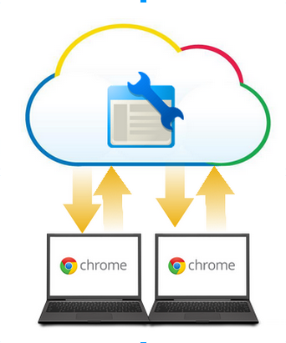
Scaling and Managing Chromebooks
Centralized cloud-based management
Security built in
Forever fresh
Customized experience
Notes:
So this is one of the critical differences with Chromebooks compared to every other device out on the market: They are incredibly easy to manage.
If you are in tech or if you talk to your tech department, you know that managing devices takes up a significant portion of their time. Buying licenses and installing software locally, setting up antivirus controls and continually checking to make sure they're running and updated, wiping and reimaging devices periodically. All of these things are very time consuming, and cost intensive.
Since the Chrome devices are entirely web based, it makes management a breeze. Chromebooks shift the model away from the old way of managing where you have to go device by device, installing software, installing antivirus, running updates, clearing memory space, etc. With Chromebooks, you can manage all of your devices through one centralized web page for the management console. Through the management console, you're able to control device settings and to set security controls on all of your computers. For instance, you can specify who can sign into your devices, whether you want your users to be routed through a proxy server, and whether to block certain things like cookies and plug ins.
From an IT perspective, Chromebooks are as secure as you can make a machine. They provide multiple levels of security, including sandboxing, data encryption, and verified boot. You don’t have to worry about malware or viruses. Because there is no hard drive, there is nothing to attack.
One of the most beneficial elements of Chromebooks is that they are always fresh. Google releases a new and improved operating system about every 7 weeks, so your Chromebooks are always running the best and most recent version of the OS. This improves your user's experience, but also means that when we release new tools to the management console, you'll have immediate access to them as well.
Another great thing that you're able to do through the management console is to create a customized learning environment for your students by controlling their user experience. Talk off-the-cuff about user experience.
Through the console, you can whitelist and blacklist websites. You can have webpages, like your schools homepage or a specific class site, automatically load when a student signs into a device. Also, through just a few clicks, you're able to provide your students with access to the web-based applications you have chosen for them to use in the classroom. This customized learning environment is available to your students no matter which Chromebook they pick up. A student can sign in to any device and have access to the resources that you have provided to them.
All of these benefits are a universal experience across all Chromebooks, because they're grounded in the idea of the web as a platform.
Because they're so easy to use and to manage, and because they're so shareable, Chromebooks are simple to scale.
1. More productive users. Technology just works. OS Updates are pushed.
2. Easy to manage. Do a demo of the management console:
login: admin@g1usd.org
pw: gmailrocks1
Settings tab: Chrome OS settings
Org settings: what the user sees, customize for different grade/groups and control url domains, website blacklists, apps,
App settings: which apps you want to allow access to for certain groups (manage), or manage pre-install apps and find apps like Spanish, etc.
Cloud-based management
Configure and manage key settings centrally
Security built-in
Provide multiple layers of protection including sandboxing, data encryption, and verified boot
Forever fresh
Chromebooks and apps update themselves; new users sign into a fresh computer
Customized experience
Create a tailored web-based learning environment with specific apps, themes, and extensions to install

Slide 35

Going Google

Slide 36
Ready to launch?
Domain(s), Email
GAFE
Provisioning Accounts
Training: IT Staff, Teachers
Professional Development: Integration
Supports
Deployment

Slide 37
Enterprise Strategy
(You’re running a business)
Standardize
Infrastructure
Devices
Future Proof
Processes – How we do things.
Support
Training/Professional Development

Slide 38


Wireless

Slide 39
End User Devices
Were not always very good at predicting the future, however we can say with confidence:
That future devices will be Wireless and Mobile.
We will require more bandwidth
Without a robust wired infrastructure in our schools, wireless is useless.
Notes:
Support media Rich applications, Video streaming, Khan Academy(ish)

Slide 40
Connect with other educators
Web Resources
Training center: http://edutraining.googleapps.com/
Guide to Going Google
Events
Summits, webinars, and hangouts
Calendar: http://www.google.com/edu/news-calendar.html
Programs
Google Apps Certified Trainer Program
Google Teacher Academy
Notes:
Many schools have been extremely successful with Google technologies, not becuase they've made large investments in consulting and training services, but because there are very developed user communities for teachers and administrators to leverage.
Here are a few of the resources available on our website (go through the bullets listed above)
There are a ton of web resources to leverage to learn more, including the Google Apps for Education training center and Google Groups focused on Apps and Chromebooks.
There are regional events and summits to take advantage of
If you'd like to learn more outside of today's webinar, we have lots of online tools and resources for you to use. (Go through bullets above)

Slide 41


Available on amazon.com

Slide 42

Michael Casey
mike@eiregroup.com
619-241-9195
Thank you!

